Slide 1
Pascal’s Triangle
By Marisa Eastwood

Slide 2
Goals and Objectives
Goals: To create Pascal’s Triangle using quarters and determine different probabilities
Objectives
With Pascal’s Triangle students will determine different patterns that lie within the triangle
With the same triangle students will learn how to predict probabilities of flipping a coin

Slide 3
Materials
4 Quarters
Pencil
Pascal’s Triangle Template

Slide 4
Procedure
Part A: Create the first 4 rows of Pascal’s Triangle using quarters
1. Determine what the top number of the triangle by thinking about how many ways there are to flip no heads or no tails.
2. Create row 2 using 1 quarter to see how many ways there are to flip a head or flip a tail.
3. Create row 3 using 2 quarters to see how many ways there are to flip a head or flip a tail.
4. Create row 4 using 3 quarters to see how many ways there are to flip a head or flip a tail.

Slide 5
Procedure
Part B: Create the next 4 rows of the triangle without using quarters.
5. Determine the different patterns that exist in the first four rows to help create the rest of the triangle.

Slide 6
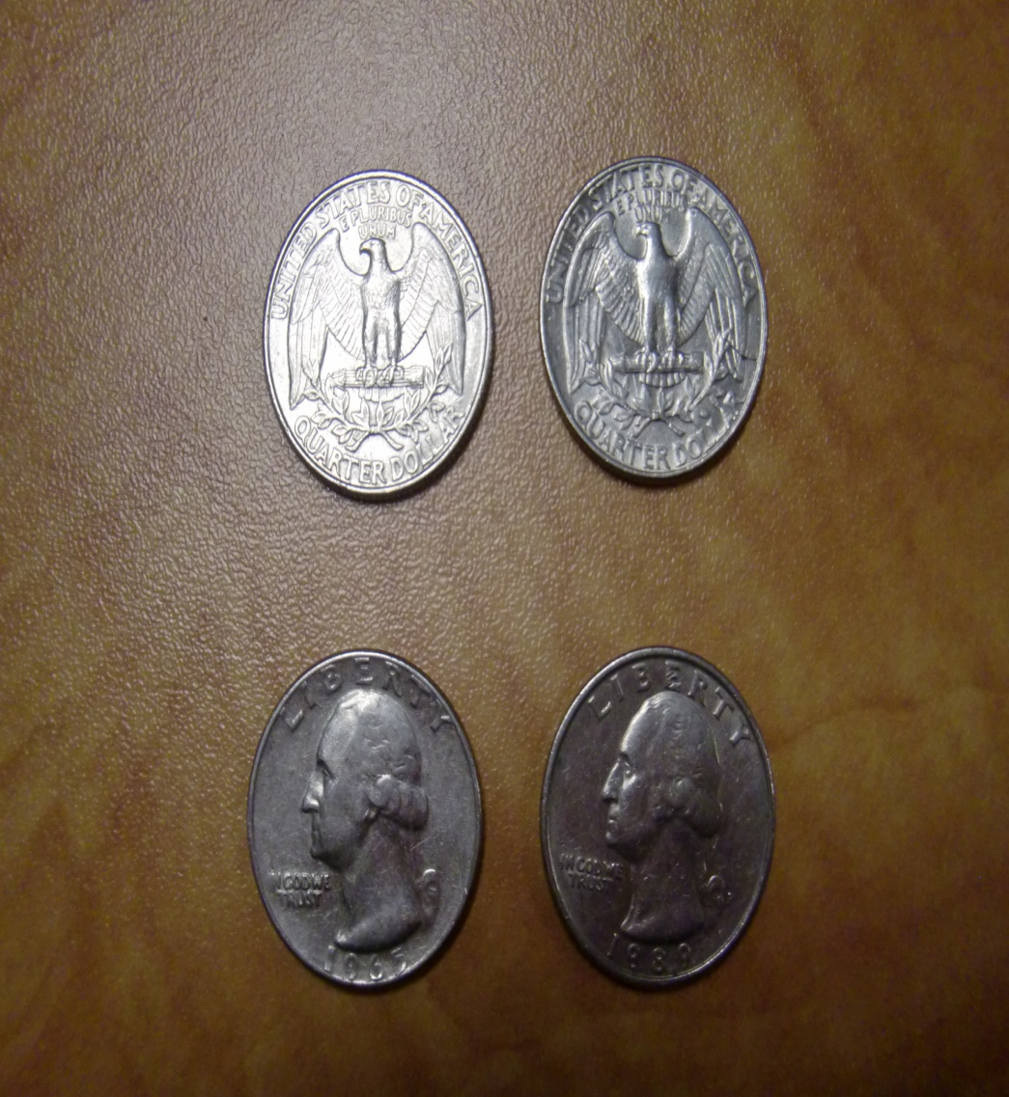
Student determining different combinations of heads and tails

Slide 7
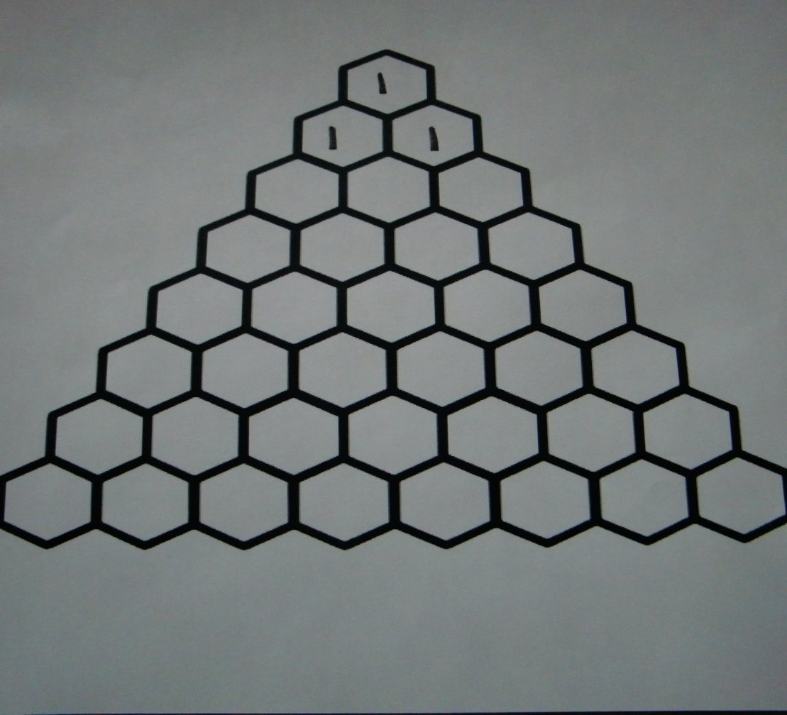
How to fill in Pascal’s Triangle using quarters
1st Row: The “point” of the triangle will always be one. This is because there is only one way to flip zero heads or zero tails
2nd Row: With one quarter, you can either flip one head, or one tail

Slide 8
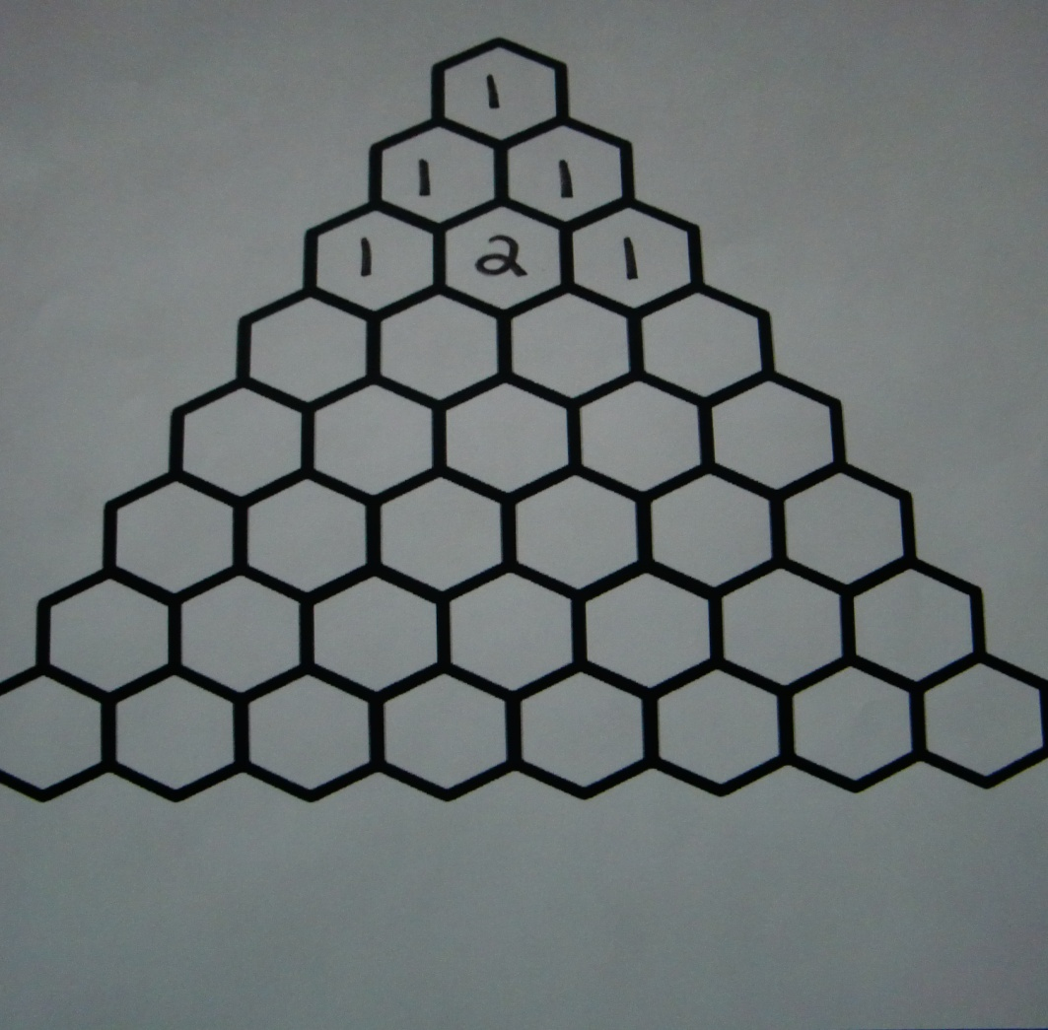
How to fill in Pascal’s Triangle using quarters
3rd Row: Using 2 quarters, you can either flip HH, TT (which represent the 1’s on the ends) or HT, TH (which represents the 2 in the middle.

Slide 9
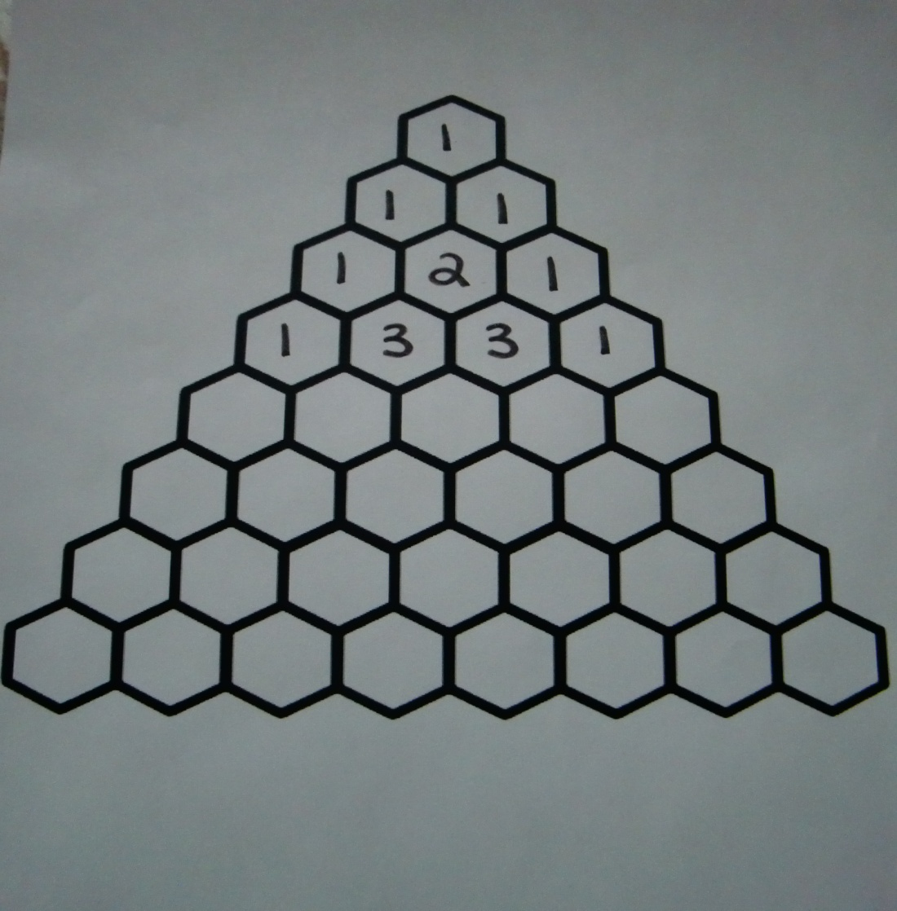
How to fill in Pascal’s Triangle using quarters
Row 4: Using 3 quarters you can either flip HHH, TTT (which represent the 1’s on the end: HHT, HTH, THH or TTH, THT, HTT (which represent the 3’s in the middle of row 4)

Slide 10
Finding different patterns in the triangle
We can see the ends of each row will be 1
Starting with 1 and going diagonal, there is another pattern of “counting” numbers
Another pattern that exists is the “triangle” pattern; the two numbers added together give the “point” of the triangle (moving down Pascal’s Triangle)

Slide 11
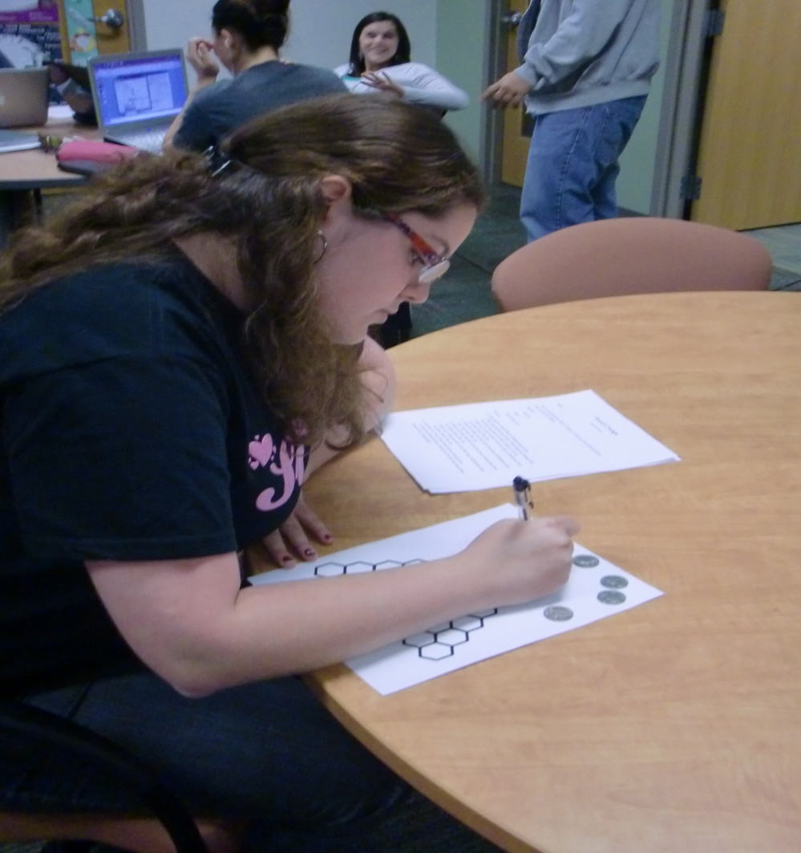
Student finding different patterns and filling in chart

Slide 12
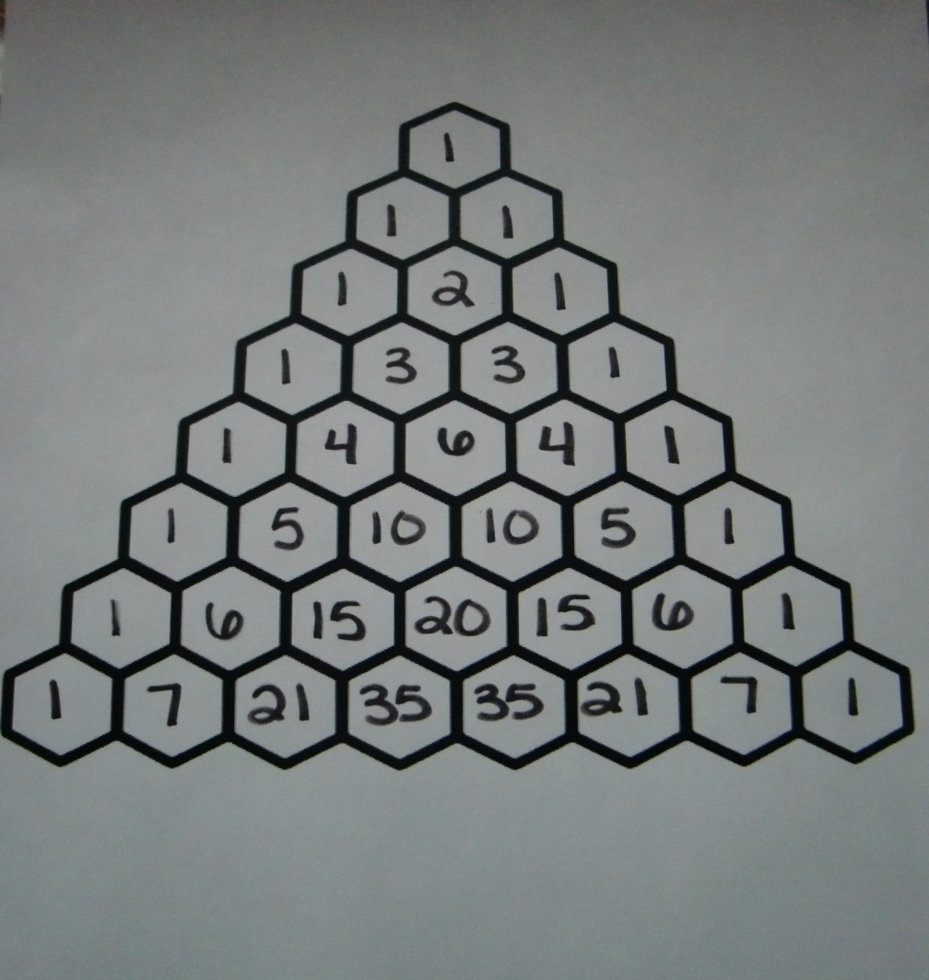
Student’s chart filled in!

Slide 13
Determining probability of flips
What is the probability of tossing a coin 6 times and getting all tails? 1/64
What is the probability of tossing a coin times and getting 2 heads and 1 tail? 3/8

Slide 14
Conclusion
Now the student should be able to successfully fill in Pascal’s Triangle and use it to determine probability!

